Slide 1

Internal Controls for Non Profits
Viable solutions that are easily applied
February 8, 2018
Chris Daniels
Finance Director
The Family YMCA

Slide 2
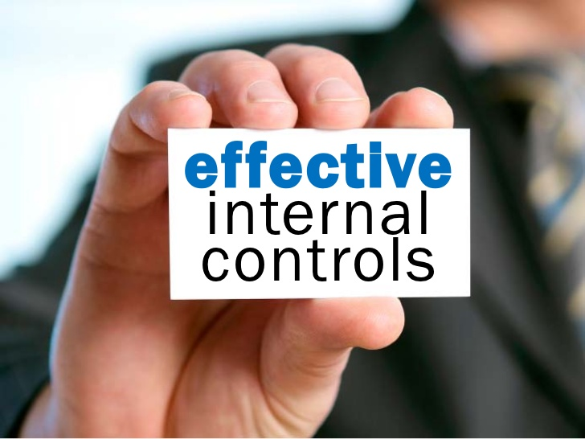
OBJECTIVES
Common ways that fraud can occur
The critical areas for internal controls
Specific controls that are easy to apply
Addressing internal controls with a limited staff
Examples of fraud and embezzlement that could have been prevented.

Slide 3
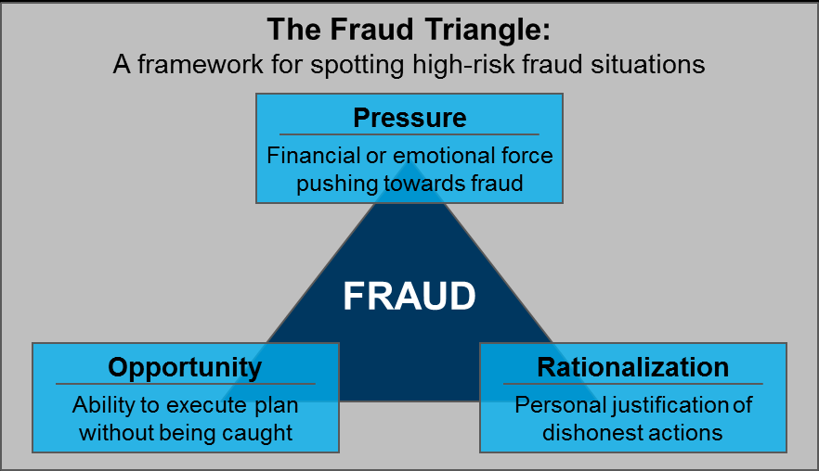
HOW DOES IT HAPPEN?

Slide 4

BRIEF EXAMPLES
“Former CFO of Nonprofit Admits Embezzling More Than $348,000 to pay for his living, travel, entertainment, and home improvement expenses.” (FBI.gov)
“Former nonprofit leader sentenced for embezzlement of $1 million from the organization to fuel an ‘out of control’ gambling habit.” (mainebiz.biz)
“Woman gets 3 years in prison for embezzling $530,000 from nonprofit… to support her $800-a-day drug addiction” (Jacksonville.com)
“Woman Embezzled $2.89 Million to Finance Shopping Addiction…bought clothes, shoes and jewelry” (wyff4.com)
“Accountant accused of spending stolen $360K on strippers” (wbrz.com)

Slide 5

SIGNS TO LOOK OUT FOR
-motivational factors-
Significant lifestyle changes
- Maintaining or attaining a socioeconomic level
Individual Needs
    -Unexpected & increased expenses – ie. medical bills, divorce
Individual Addictions
-Gambling, drugs & alcohol, shopping, illicit activities
Revenge
    - Disgruntled employees wanting to get back at the organization

Slide 6
FREQUENT SCHEMES TO BE CONSIDERED
The purchasing function is the most common target for fraud.
Abuse of a corporate credit or debit card for personal purchases
Expense reimbursement schemes (expenses are misrepresented as being legitimate business expenditures)
Writing organizational checks to pay personal bills
Shell company schemes

Slide 7

MYTH
It hardly ever happens to non profits – we don’t really have to worry!
REALITY
Non Profits rank third out of fifteen industries most frequently experiencing this kind of theft. – Nonprofit Network
Mr. X is the most dedicated, honest, kindest person I've ever met.
Our staff is so dedicated to our mission, they just wouldn’t do something like this to jeopardize our work!
We don't have enough staff to have good financial controls.
Our annual audits would catch embezzlement and fraud.
People who do bad things don't think of themselves as bad . . . and usually don't come across to others that way either!
You can be incorporate volunteers into the separation of duties!
Our blind trust provides them with opportunity!
While audits can uncover instances of fraud, it is one of the least common ways for fraud to be exposed!

Slide 8
Source: Clifton Larson Allen – Multiple responses allowed

Slide 9
Another Example
"I was a middle manager of an organization where we discovered, after the CFO left, that the CFO had embezzled $33,000. He had opened up a bank account in the agency's name at a local bank where he knew the employees. He told the ED and the board that he needed to re-do the signatures for an existing account; filled in the card where they should sign, and marked that only one signature (his) was needed to write checks. When the embezzlement came to light, the board refused to report this to the police or the insurance company. They were afraid they would be blamed." -- Blue Avocado reader

Slide 10
And Another……..
An administrative assistant embezzled more than $5 million from a Washington, D.C., organization by submitting phony invoices for small amounts over the course of several years. The employee created phony invoices on behalf of real vendors or fictitious vendors with similar-sounding names to real vendors, approved them, obtained the resulting checks, and then deposited them into an account she had opened on behalf of the fictitious vendors. Because the vendors on the invoices were either real vendors of the organization or sounded similar to real vendors, for years no one realized that the invoices did not reflect services actually rendered. -Wiley Rein LLP

Slide 11
46 percent of fraud cases
involve multiple perpetrators.
- 2014 ACFE (Association of Certified Fraud Examiners)

Slide 12

BE CONCERNED!
After and incident of fraud donors become more hesitant to support the organization, as embezzlement is a significant violation of trust and lack of oversight in an organization. It can take many years to recover from this!

Slide 13
Steps to Improve Controls
Assess the situation
Examine current system in place
How does the money flow and who
is handling the different duties.
Concentrate on high risk areas
Review accounting policies and procedures
Separate duties and establish controls
Train those involved to know their role
Don’t expect to do everything at once

Slide 14

AREAS OF HIGHER RISK
Cash Received Checks Received
Checks Written Accounts Payable
Credit Cards Payroll
Inventory
Supplies Fixed Assets
Financial Reporting Process
Board Reports Expense Reports
Grant Reporting

Slide 15

5 MUST-DO & MOST DO-ABLE CONTROLS FOR SMALL NON PROFITS
IF THERE IS CASH THEN TWO PEOPLE COUNT
DEFINE RESPONSIBILITES AND OVERSIGHT
SET THE CONTROL ENVIRONMENT
ACCOUNT STATEMENT CONTROLS
LOCK IT UP

Slide 16
4 MORE CONTROLS WITHIN YOUR REACH
Mail Coordination
Transaction Review
Vendor Review
Reporting Review

Slide 17

Story #1
Small nonprofit
Only two FTE employees that were also related
An annual budget of about $500,000
Member dues and conferences
Approximately $250,000 in reserved savings
No audit or formal review for a number of years
Board was hands off
Source: Clifton Larson Allen

Slide 18
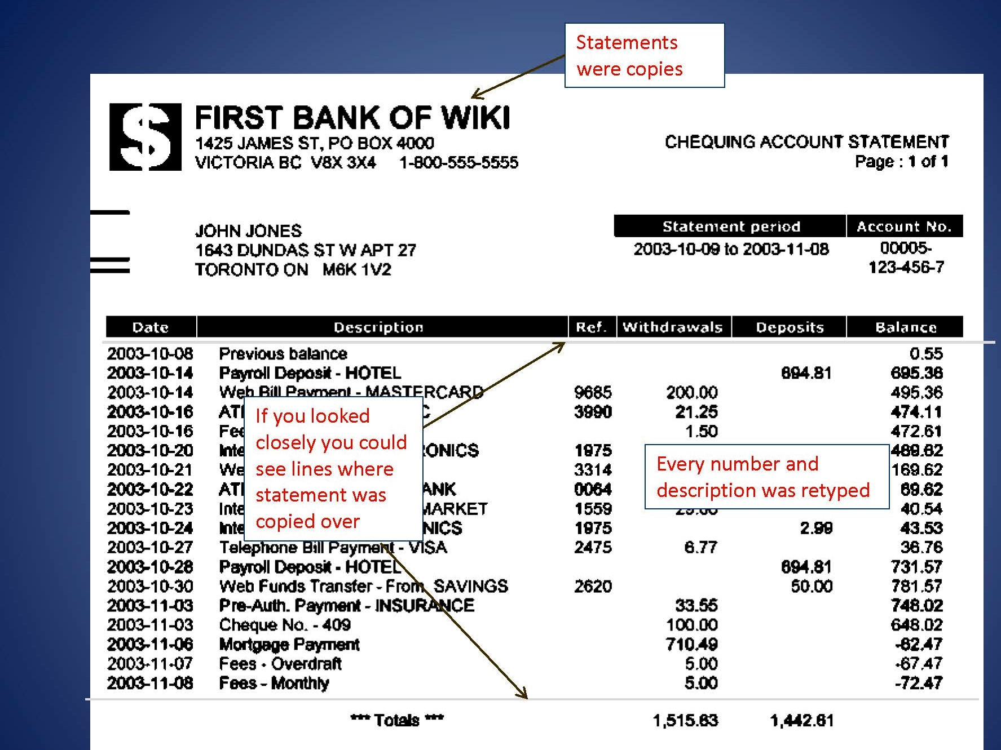

Slide 19
What Happened
Approximately $210,000 stolen
Board members had to personally loan funds to the organization
State registration lapsed (no longer had corporate protection)
Both employees were terminated
Threatened lawsuit from terminated executive director
Reputations were damaged
Tax returns were not filed
Retirement plan funds were not deposited into plan
Extensive costs to investigate and address all the above
Entity dissolved

Slide 20
How It Could Happen
Office manager had too much control
–Controll of assets
–Sole recorder of all transactions
–Received all source documents
Related parties with too much trust
Board members accepted copies of statement
Slow response when regulatory filings were missed

Slide 21
Story #2
Mid size non profit
Small accounting department of three
Department head was a 10+ year employee processed all
cash transactions including credit cards
Strong level of trust in individual
Use of many different cash and credit accounts
Source: Clifton Larson Allen

Slide 22
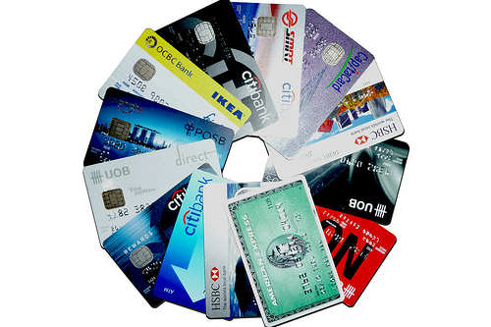
The Pressure of Personal Needs

Slide 23
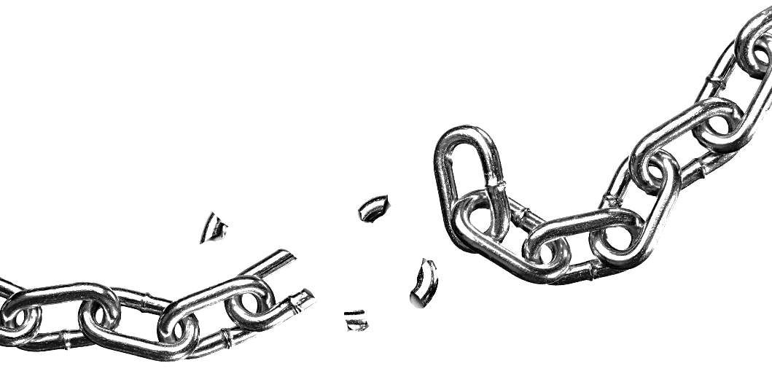
WHAT ALLOWED IT TO HAPPEN
WHAT HAPPENED
Approximately $3,000 was stolen
Federal reports were filed in error
Federal investigation
Several employees terminated
Federal charges against employee
Employee had control of entire process
Lack of review of bank reconciliations
Too much trust in long-term employee

Slide 24
OBSTICLES TO ADDRESS
LACK OF TRAINING
LIMITED STAFF OR INFRASTRUCTURE
TOO MUCH TRUST
LARGE VOLUME OF TRANSACTIONS

Slide 25
SEGREGATION OF DUTIES
Executive Director
Sign checks
ACCOUNTANT
Prepare checks
ADMINISTRATOR and/or BOARD
Create Payroll
Reconcile statements
Approve Invoices
Approve Payroll
Approve Payroll
Prepare Reports
Sign significant contracts
Review bank reconciliations
Review Account activity
Approve compensation adjustments
Open mail
Enter Invoices/Payments
Review Financial Statements

Slide 26
A Problem Occurs!
Don’t try and keep it “In House”
Act Quickly and Fairly
Use Outsiders to Investigate
Document Everything in Writing
Review Where the System Broke Down
Communicate with Your Supporters

